Slide 1
Navigation of an ETV Simulator
(Endoscopic Third Ventriculostomy)
COD310
under Professor Subodh Kumar
Aditya Jain
Parth Shah
Pratyush Maini
github.com/pratyush911/ETVSimulation

Slide 2
Objective
To create a navigation system for an ETV simulator that correctly guides a user to do an ETV. The navigation should be intuitive in the sense that it has strong correlations between the real and physical world.

Slide 3
Work Timeline
Understanding the Problem and getting the system ready
Understanding the Procedure
Learning Basics of OpenGL
Working with Chai3D and Haptic Devices: Stanford CS277
Make Small tweaks in the code and run it
Coordinated Movement on a Cylinder
Making the Movement more intuitive
Implementing with the Endoscope Version
Get Phantom Model 3D Printed and adjust camera view
Calibration of haptic device with Phantom Model
Navigating

Slide 4
Understanding the Problem
Hydrocephalus

Slide 5
Understanding the Problem
Four Ventricles in Brain
2 Lateral Ventricles, Third, Fourth Ventricle
Aquaduct joining Third and Fourth Ventricle gets blocked
CSF (Cerebro Spinal Fluid) get trapped
Enlargement of Third and Lateral Ventricles

Slide 6
Understanding the Problem
Reading through MRI Images

Slide 7
Understanding the Problem
Choroid Plexus generates CSF
CSF circulated in brain
Absorption by Arachnoid granulations in brain
Re-production of CSF in Choroid Plexus

Slide 8
Installing Libraries & Getting the System Ready
Received System in early February
Installed libraries for Chai3D, OpenGL ..
Tested that the inherited code executes

Slide 9
Understanding the Procedure
Create a burrhole at a suitable location.
Ideally straight line path without disturbing sensitive arteries & veins.
Rigid Pivoting of endoscope at the point of burrhole.
Jelly like nature of gyri in brain
Can be pierced, rejoins when endoscope removed

Slide 10
Understanding the Procedure

Slide 11
Understanding the Procedure
Navigate the endoscope
Following the Choroid Plexus (red in colour)
Special care for Fornix – leads to memory loss
Perforate through the Foramen of Monro

Slide 12
Understanding the Procedure
Complications involved
Fornix should not be damaged
Basilary Artery should not be touched – Locates at the base of the third ventricle
Vital nerves should not be hit during navigation– may lead to loose of senses/ death

Slide 13
Understanding the Procedure
Visit to AIIMS for understanding the problem

Slide 14
Learning Basics of OpenGL
Understanding Basics of OpenGL
Shaders, Transformations, Homogenous Coordinate System

Slide 15
Practice Codes / Tutorials OpenGL
GLFW, GLUI libraries
Opening windows
Drawing triangles
Basic Shading
Input Output
Put up on Git repository

Slide 16
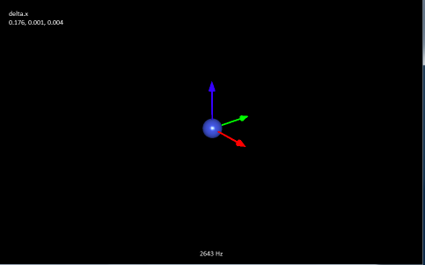
Working with Chai3D and Haptics
Over 30 Example Chai3D Programs with use of Mesh, Force, Haptic Endoscope, Field effects etc.

Slide 17
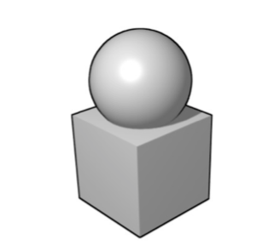
Working with Chai3D and Haptics
Stanford CS277: Course on Experimental Haptics
Part I - Shapes Using Force Fields
Part II - Inverting the Force Fields
Part III - Animating the Objects
Good Introduction to Libraries

Slide 18
Make Small tweaks in the code and run it
Working on Modularized Code
Adding I/O operations to introduce more readability.

Slide 19
Mid Semester Break

Slide 20
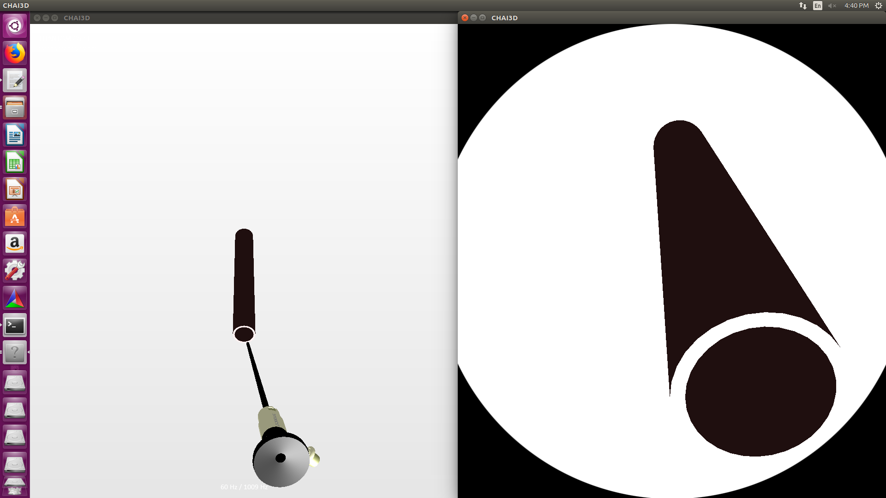
Coordinated Movement on Cylinder
Getting Navigation to work on Cylinder proto-type

Slide 21
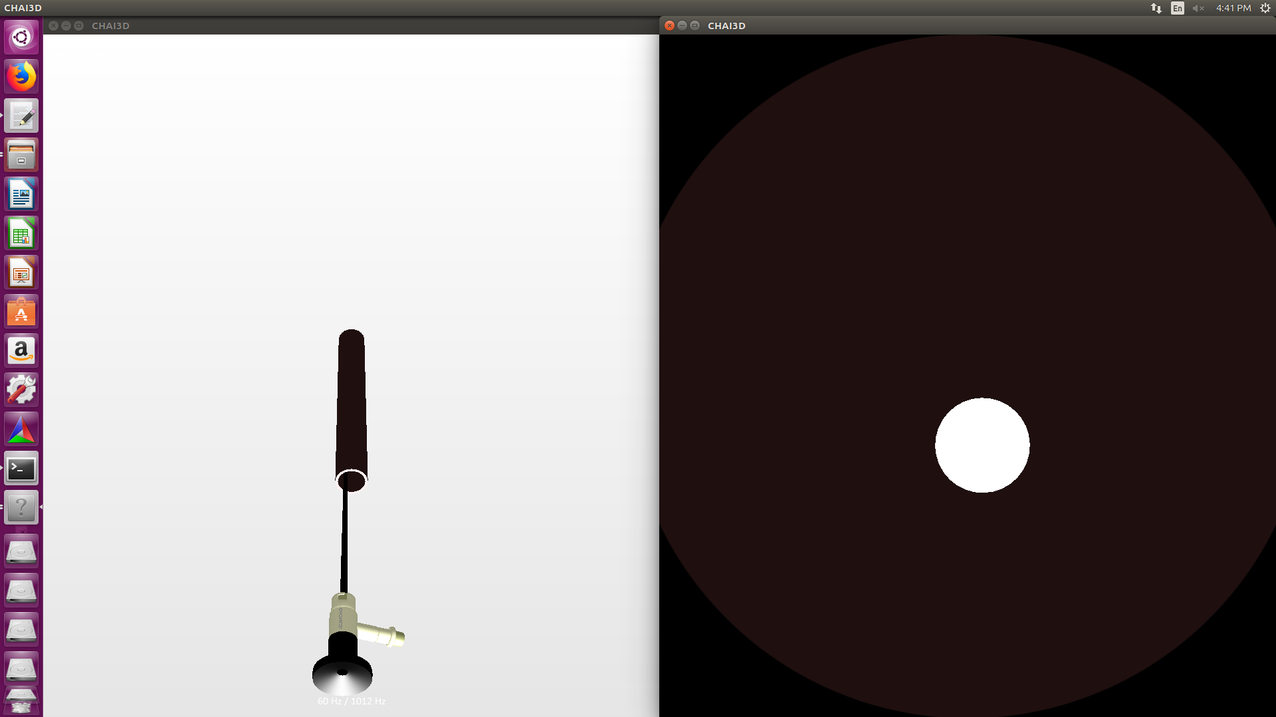
Coordinated Movement on Cylinder

Slide 22
Intuitive Navigation
What is intuitive for us might not be how an endoscope works?
Physical Translation → Virtual Translation ? YES
Physical Rotation → Virtual Rotation ? YES & … NO

Slide 23
Adjusting Camera View
Two Choices – Rotation Allowed / Static Viewing Angle
Static Viewing Angle during translation
Rotation during halts

Slide 24
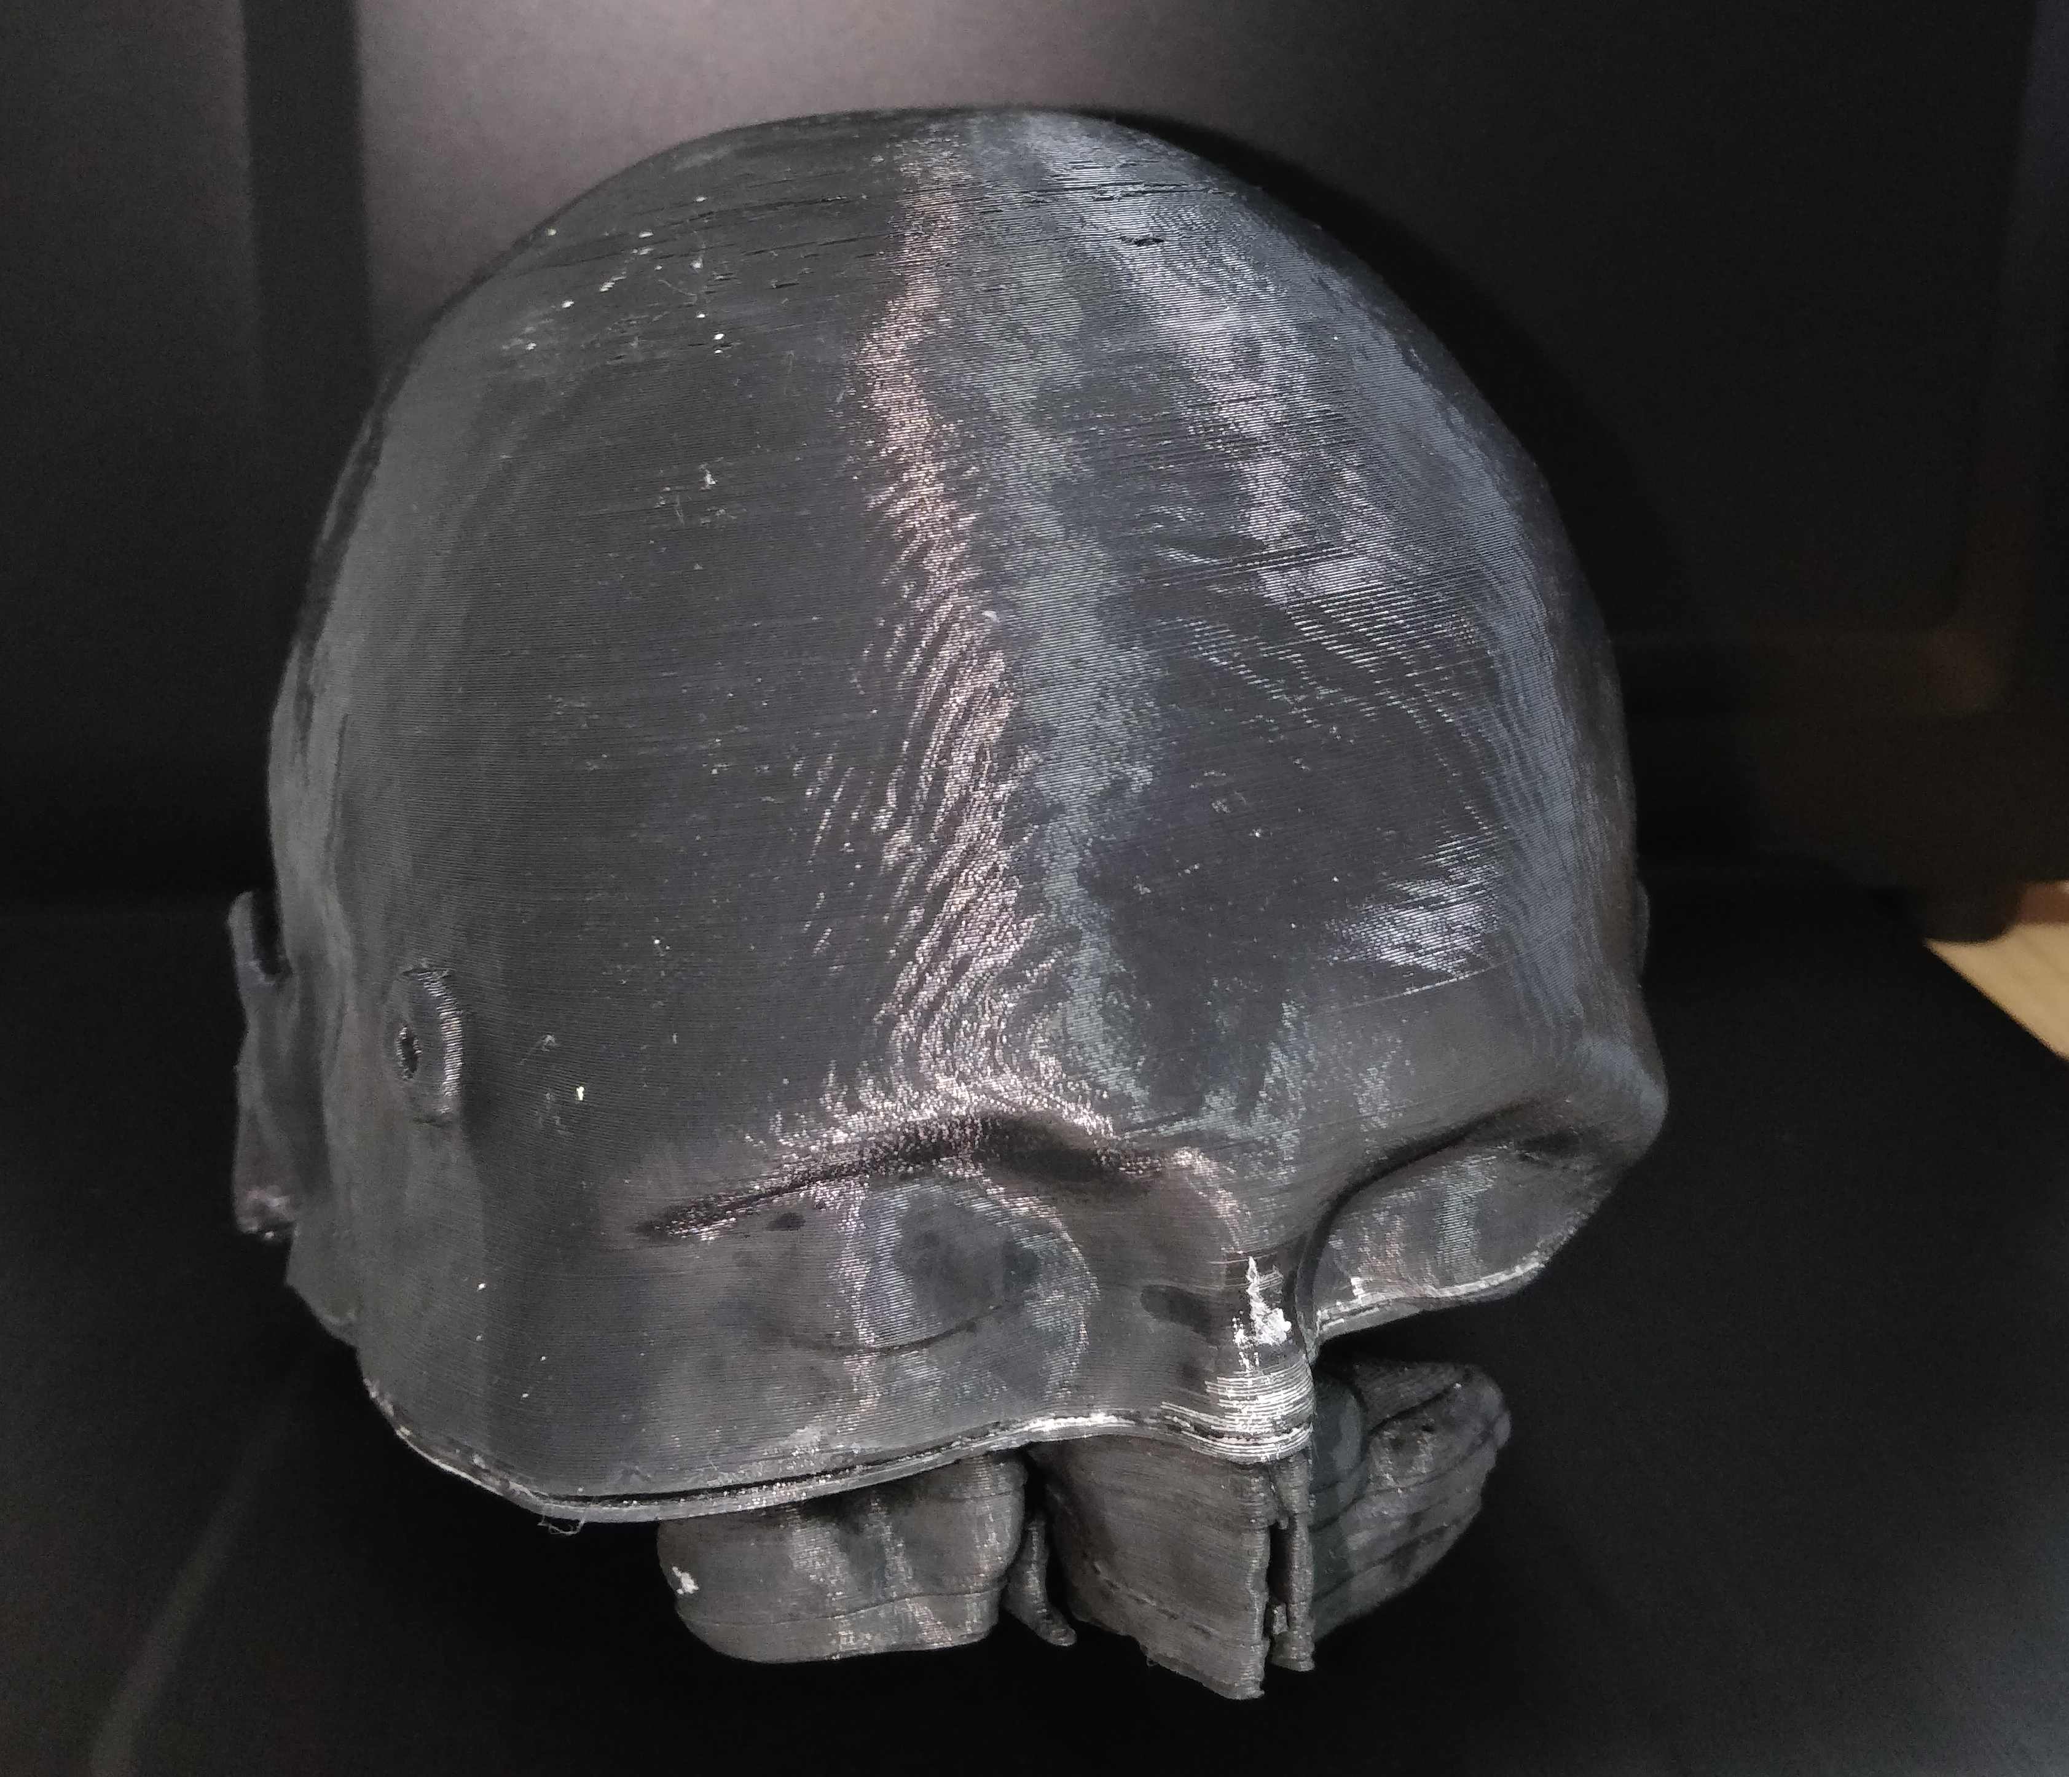
Get Phantom Model 3D Printed
Printed in IIT Delhi
Markings on the skull for calibration
STL file for printing not compliant with VoxelFile for Virtual Diagram

Slide 25
New Virtual Copy Created
DCM to PNG Conversion
Reconstructed a new 3D Virtual Model in Compliance with the 3D Printed Physical Model
PNG to Voxel Conversion

Slide 26
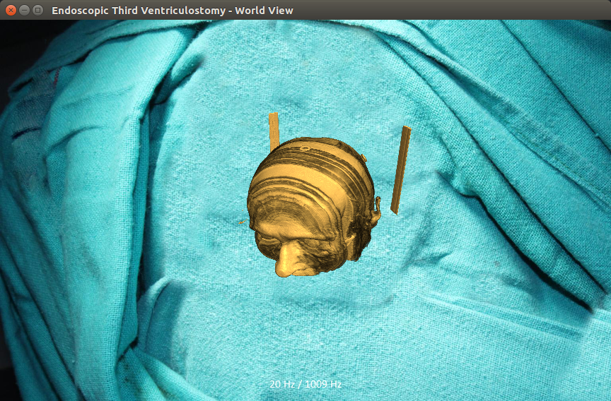

Slide 27
Calibration of haptic device with Phantom Model
Voxel to Multi-Mesh Conversion
Polygonisation Approach

Slide 28
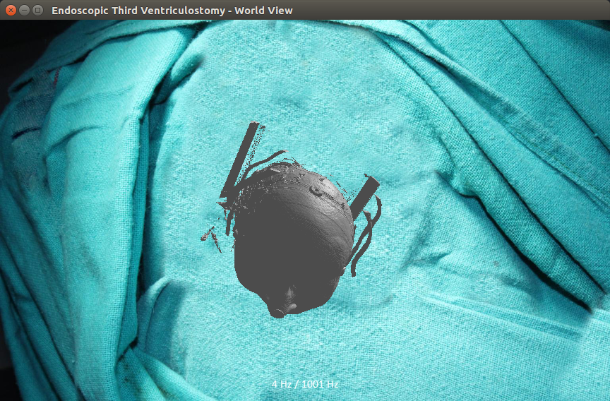

Slide 29
Calibration of haptic device with Phantom Model
Local 3 points algorithm developed for coordinate calibration.
Rigid ICP / MeshLab not a feasible option
Accuracy v/s Feasibility Trade-off
Static followed by Dynamic Calibration

Slide 30
Calibration Algorithm
Step1: Scaling
Step2:Rotating to align normal vectors
Step3:Translating to match one point of virtual space and its corresponding real point
Step4:Rotating to match all points

Slide 31
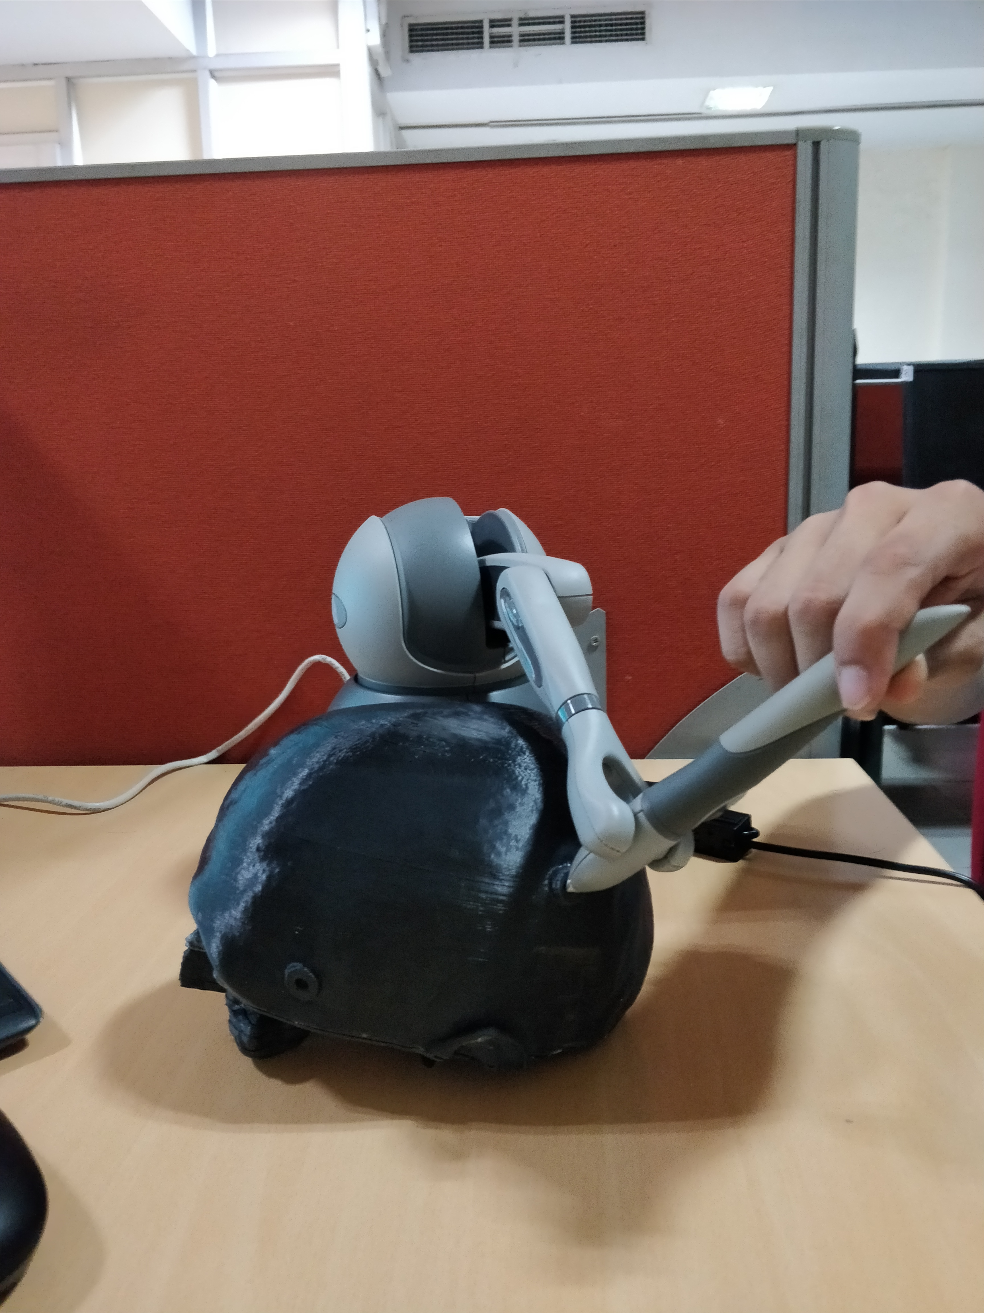
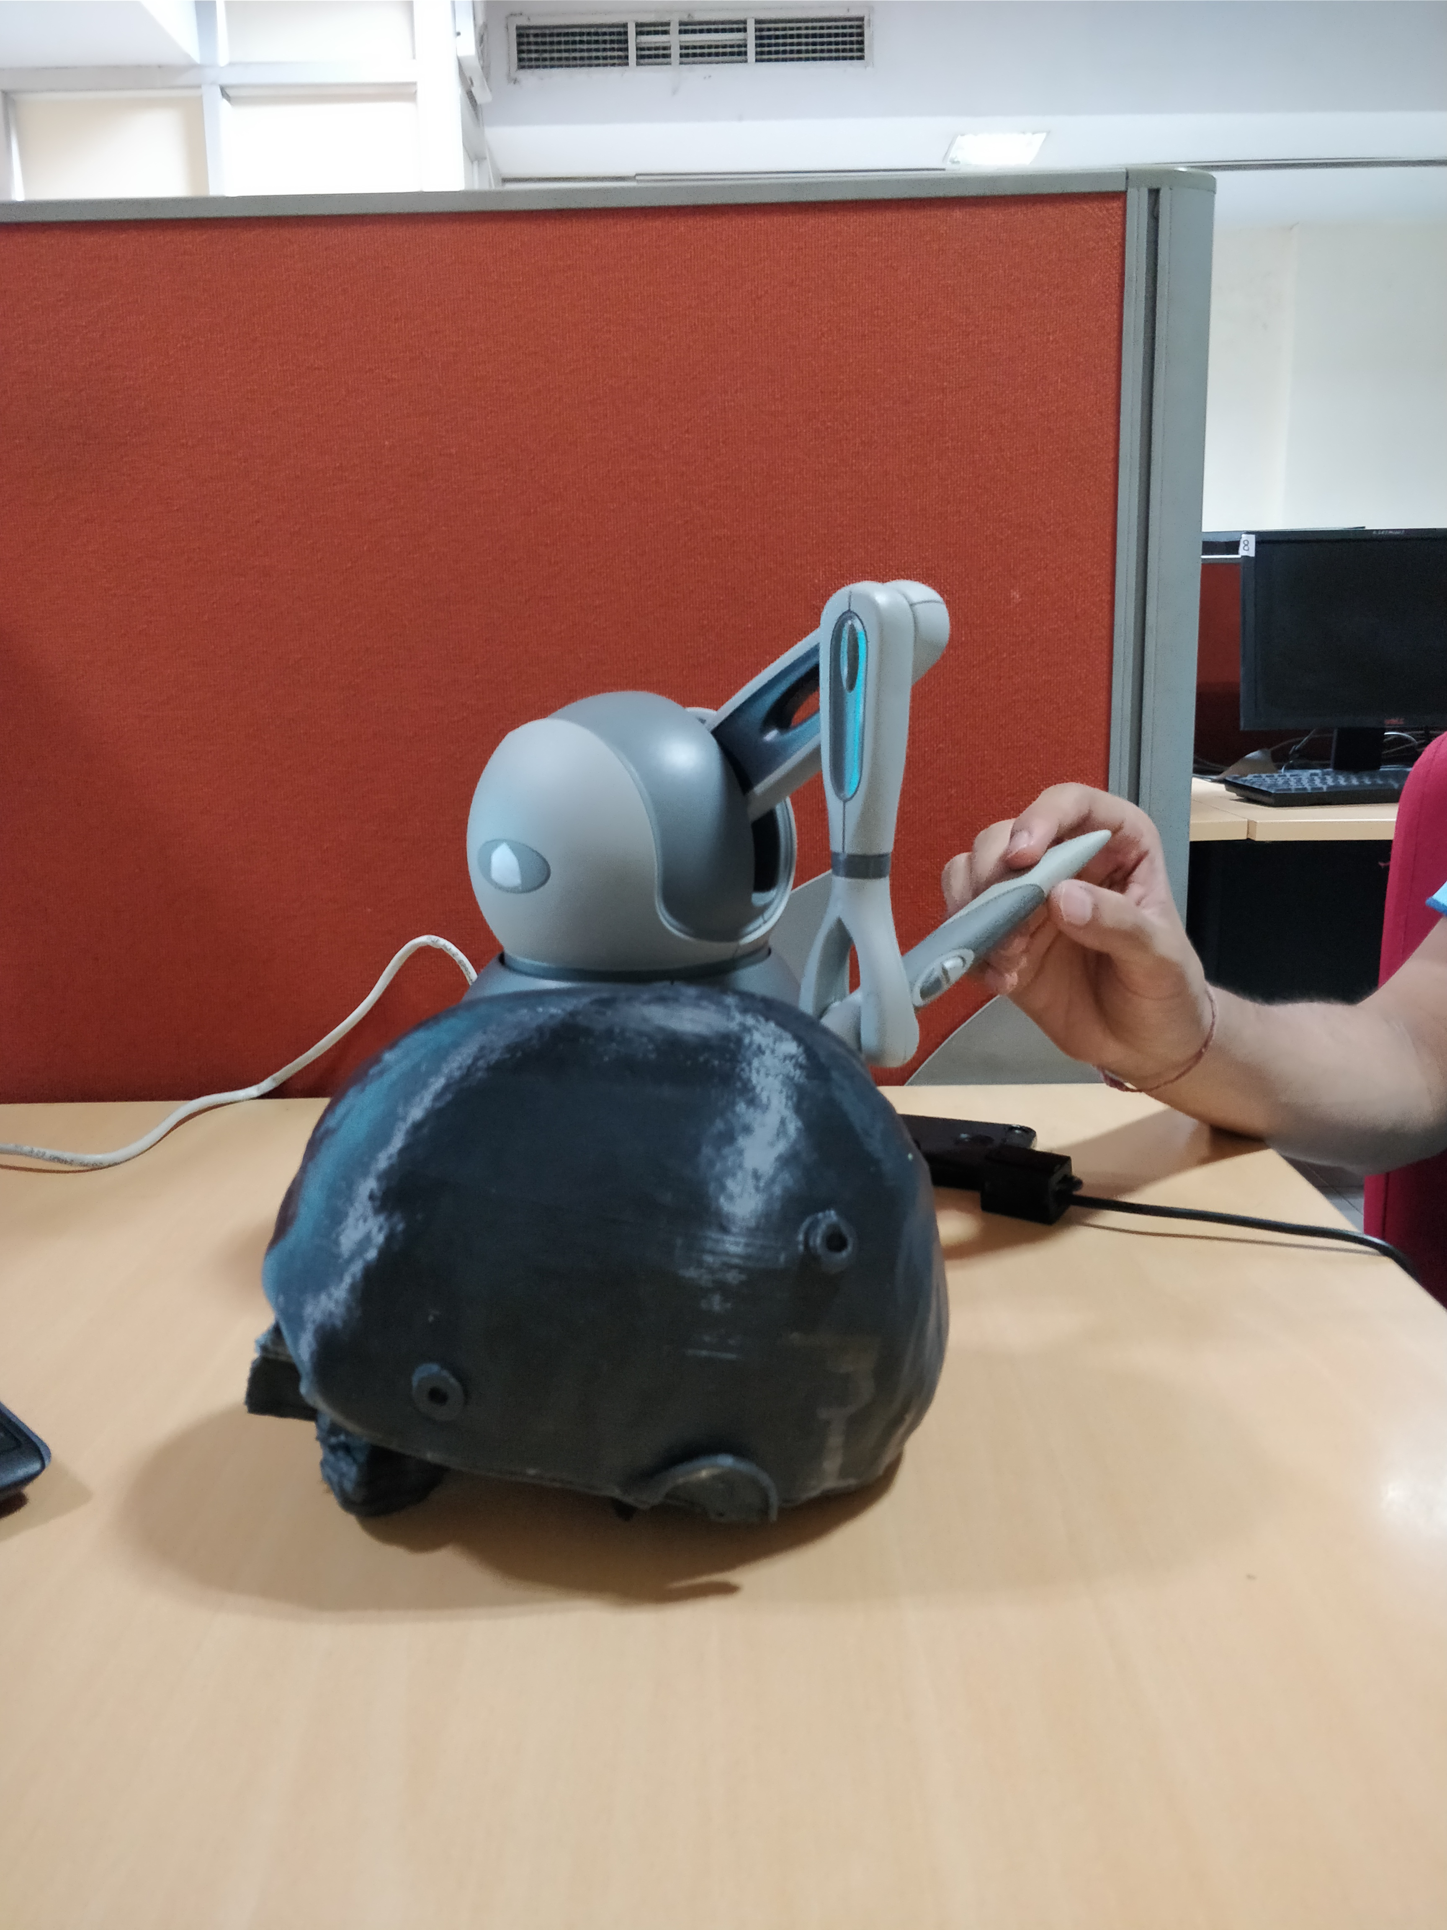

Slide 32
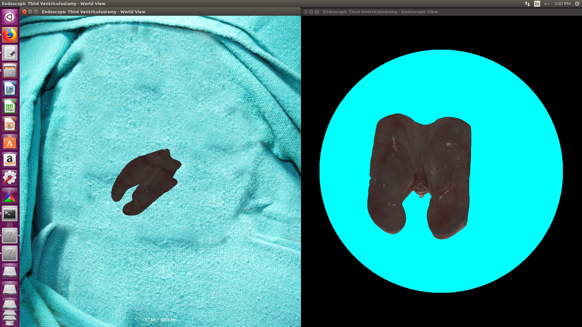
Navigating through the 3D Model

Slide 33
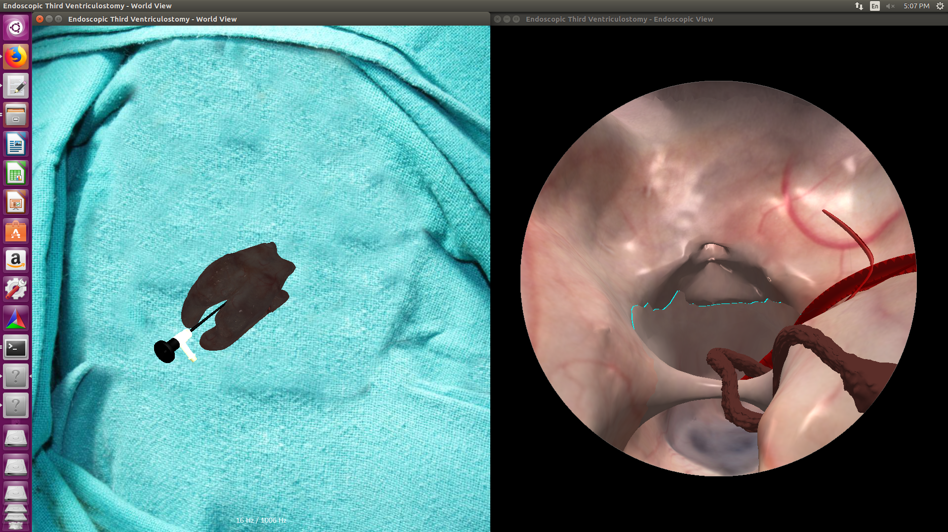

Slide 34
Thank You

